Slide 1
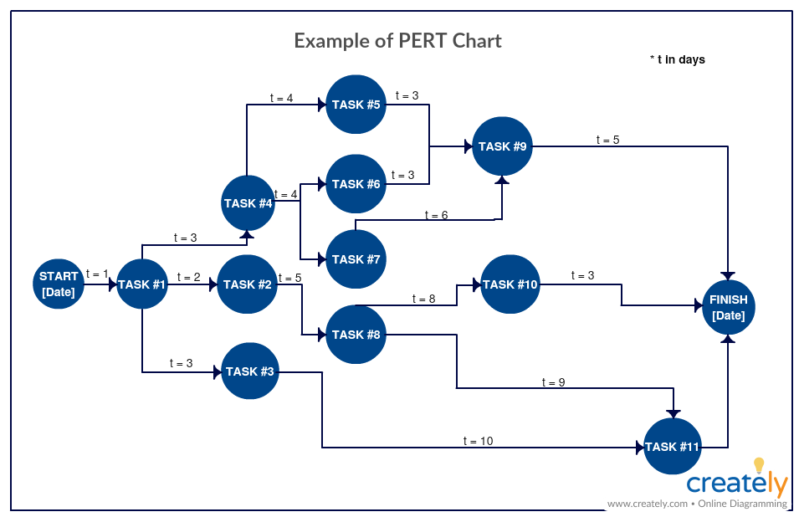
Pert Chart
Today
Workshop

Slide 2
For my part:
Lot’s of partially written documents!!!
For you:
You have your “Assignments”
Inshallah

